Slide 1
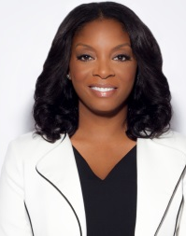
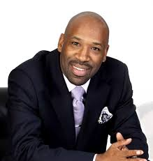
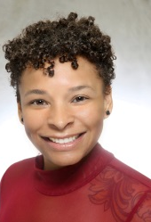
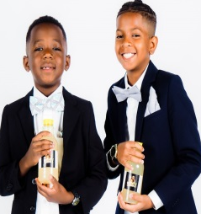
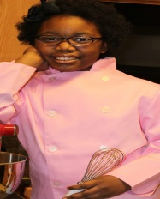
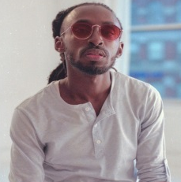
Fabiola Jean
Demarjay Smith
Nadia Lopez
Jr Flip Kids
J Alexander Martin
Adrien Garcia
Lisa Puerto
Brown boys
Wynter Hubbard
Raval Davis
Lemonade
- - - - -
Sabrina Abraham
Quardean
Chef Destiny
Blacka Di
Sakinah Bates
Theda Germain Kidpreneur Award Prizes
Sponsored By: Proven Winners Realty
Lewis-Allen
Harris
Danca

